Slide 1
Software Development Lifecycle
Framework for application development at UL
V3.0 January 2011

Slide 2
How are we doing today? Some experiences from recent projects. . .
Quality, Requirements
Implementing bug fixes creates new problems
Number of bugs increasing rather than decreasing
Too many mouse clicks required to perform simple actions
Application is frustrating to use, too slow and not intuitive
Some functions no longer working after changes were implemented
User & network readiness not addressed prior to deployment
Large number of defects in the released code
Application is not documented, requiring reverse engineering to make changes
Project Management, Roles and Responsibilities
Multiple Project scope changes without any impact or risk assessment
Estimate did not align with reality
Key stakeholders/team members not available to support project when needed
Testing responsibility was not clear, inadequate test coverage – no clear owner for testing the application
The IT Survey indicated that only 42% considered the Technology Division as an excellent or good value to UL. Drivers that limit value value to UL include:
Lack of up-to-date technology
Poor technology performance
Solutions becoming a hindrance to daily productivity

Slide 3

Voice of our Colleagues:
One thing UL’s IT Division could do to improve development projects?
Conduct Effective Requirements Gathering
22%
“Get more people involved that would use it in the development and testing stage.”
Overall Development Projects
17%
“Learn the art of project management.”
Timely Implementation
15%
“I've submitted several "easy" IT Service Requests recently, and this "new" IT process seems to take forever. I also submitted the same requests over a year ago, and nothing was ever done.”
“Understand what the end users do with the product. This continues to be a shortcoming of this process.”
“When a request is considered "small" from an IT development perspective and the business (and the customer) has requested it, I would like to see these types of small changes worked in with the larger projects for each release.”
“Act faster to implement improvements.”
Notes:
3

Slide 4
Why do we need a Development Framework?
Improve our ability to deliver
“on-time”,
“on-budget” and
“on-scope”

Slide 5
What is being implemented?
Software Industry best-practices
Defined Process Framework
Stakeholder involvement at key Phase Gates
Opportunities for go/no-go decisions within the process
Specific deliverables within the development phases
Continuous improvement built into the process
Benefits
Less reliance on on individual heroic efforts for success
Discipline to do it right the first time
Time allocated specifically for planning before coding begins
Clear direction & less rework (fewer missed requirement and defects)
Higher quality (deliver what customer envisioned on value)
Reduced total cost of ownership
Continuous Improvement ensures processes are adjusted based on lessons-learned
Collaborative ownership of results providing value-added and more reliable service to the business
Improving our ability to deliver “on-time”, “on-budget” and “on-scope”

Slide 6
Key elements of the SDLC Framework
Unified Requirement Management
Consistent requirement gathering
Requirement validation
User Experience Design (UXD)
Business sign-off
Test Plans
Requirement tracking (using Microsoft’s Team Foundation Server)
Early detection of risks and issues
Identify risks and issues earlier in the development process through formal reviews of requirements, solution design, code, and test results
Continuous improvement
Learn from our experiences, then incorporate lessons-learned into the established processes, checklists, and templates
Improving our ability to deliver “on-time”, “on-budget” and “on-scope”

Slide 7
How is this Framework being implemented?
Projects
Framework will be used for the top seven IT initiatives
Sessions will be scheduled with the leaders of these projects to provide detailed overview of this Framework
SDLC Steering Committee
Consists of IT Directors, Global Quality Director, and others
Meets monthly to ensure implementation continues, addresses roadblocks and issues
Ensures ongoing alignment with the EPMO process
Project Managers and Business Analysts
Project Managers, Business Analysts, other key stakeholders will be trained on SDLC
Phase Gate Reviews
First element of SDLC to be implemented
Checklists will be available, and Project Managers and Business Analysts will be provided an overview of how to apply elements of the SDLC to their projects
Some templates and examples of deliverables will be available at the start, more will be added over time
Improving our ability to deliver “on-time”, “on-budget” and “on-scope”

Slide 8
Who are the key participants?
Project Managers/Business Analysts
Initiate the Phase Gate Reviews
Facilitates stakeholder collaboration
Manages the project to successful completion
Project Team (Business Stakeholders & IT Development, Quality)
Takes ownership of respective deliverables
Actively participates in the Phase Gate Reviews
Jointly responsible for achieving desired results
Improving our ability to deliver “on-time”, “on-budget” and “on-scope”

Slide 9
Introduction to the SDLC Framework
Overview of major phases and key deliverables

Slide 10
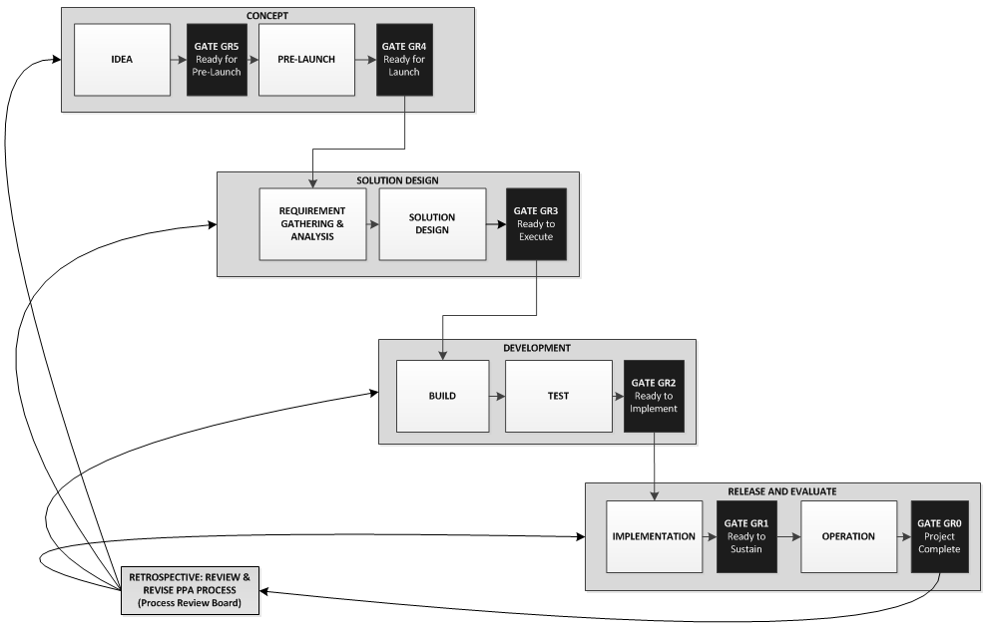
UL Software Development Lifecycle

Slide 11
Development Lifecycle: CONCEPT
Project Manager Facilitates Phases
Primary Actor: Business
Gate GR5: Ready for Pre-Launch
Ideas
Idea Statement
Project Request
Primary Actors: Business, IT
Gate GR4: Ready for Launch
Business Case
Defined Scope
Financial Review
Project Size Estimate

Slide 12
Development Lifecycle: SOLUTION DESIGN
Project Manager Facilitates Phases
Primary Actors: Business, IT
Gate GR3: Ready to Execute
Requirement gathering, analysis, approval
Architecture Review
Solution design
Testing Plans developed

Slide 13
Development Lifecycle: DEVELOPMENT
Project Manager Facilitates Phases
Primary Actors: Business, IT
Gate GR2: Ready to Implement
Design completed
System, Integration, and UAT test plans with results
Training content developed
Communication and Implementation plans complete

Slide 14
Development Lifecycle: RELEASE
Project Manager Facilitates Phases
Primary Actors: Business, IT
Gate GR1: Ready to Sustain
Fully implemented
Training completed
Transfer to Operations
Primary Actor: Business
Gate GR0: Project Complete
Assessment of value to business
Retire replaced systems
Completed retrospective of project
Project report

Slide 15
CONTINUOUS IMPROVEMENT
Project Manager Facilitates Phases
Primary Actors: SDLC Process Owners
Continuous Improvement
Regular evaluation of the ability of the process to meet UL’s needs
Manage process changes suggested from project retrospectives

